Slide 1
Test Case writing techniques
Alaa Gamal

Slide 2

Agenda
What is Software Testing?
Why software testing is important?
Software Testing Life Cycle – STLC
Testing techniques
What is a Test Case?
Test Case Construction
How to write a test case?
Test Case Fields
Test case Design Techniques
Test Case Types.
Practice.

Slide 3

What is software testing?
Def. 1
Software testing is an activity to check whether the actual results match the expected results and to ensure that the software system is defect free.
It involves execution of a software component or system component to evaluate one or more properties of interest.
Def. 2
Software Testing is a process of verifying a computer system/program to decide whether it meets the specified requirements and produces the desired results.
As a result, you identify bugs in software product/project

Slide 4
Why is Software Testing Important?
Testing is important because software bugs could be expensive or even dangerous.
Software bugs can potentially cause monetary and human loss, history is full of such examples.
Notes:
In April 2015, Bloomberg terminal in London crashed due to software glitch affected more than 300,000 traders on financial markets. It forced the government to postpone a 3bn pound debt sale.
Nissan cars have to recall over 1 million cars from the market due to software failure in the airbag sensory detectors. There has been reported two accident due to this software failure.
Starbucks was forced to close about 60 percent of stores in the U.S and Canada due to software failure in its POS system. At one point store served coffee for free as they unable to process the transaction.
Some of the Amazon’s third party retailers saw their product price is reduced to 1p due to a software glitch. They were left with heavy losses.
Vulnerability in Window 10. This bug enables users to escape from security sandboxes through a flaw in the win32k system.
In 2015 fighter plane F-35 fell victim to a software bug, making it unable to detect targets correctly.
China Airlines Airbus A300 crashed due to a software bug on April 26, 1994, killing 264 innocent live
In 1985, Canada's Therac-25 radiation therapy machine malfunctioned due to software bug and delivered lethal radiation doses to patients, leaving 3 people dead and critically injuring 3 others.
In April of 1999, a software bug caused the failure of a $1.2 billion military satellite launch, the costliest accident in history
In may of 1996, a software bug caused the bank accounts of 823 customers of a major U.S. bank to be credited with 920 million US dollars.

Slide 5
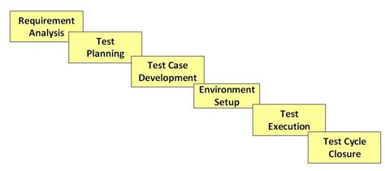
Software Testing Life Cycle – STLC
Notes:
https://www.guru99.com/software-testing-life-cycle.html

Slide 6
Testing Techniques
Equivalence Partitioning
Boundary Value Analysis
State Transition Testing
Use Case Testing

Slide 7
Testing Techniques: Equivalence Partitioning (EP)
A portion of an input or output domain for which the behavior of a component or system is assumed to be the same, based on the specification.
Example:
The ADC_CheckValue function shall return E_OK, In case of the Temp_Value is in range of 20 to 50.
Invalid Patrion
Valid Patrion
Invalid Patrion
Temp_Value
E_NOK
E_OK
E_NOK
20
50
Number of minimum test cases is 3
TC1: Invalid Patrion in case Temp_Value < 20
TC2: Valid Patrion in case 20 < Temp_Value < 50
TC3: Invalid Patrion in case Temp_Value > 50

Slide 8
Testing Techniques: Equivalence Partitioning(EP)
Benefits of equivalence partitioning
Improve the efficiency and effectiveness of your test execution.
By using fewer test cases, you can reduce the testing effort, cost, and duration, while still achieving a high level
of coverage and quality.
Avoid redundant or unnecessary test cases that do not add any value to your testing.
Identify and isolate defects more easily, as you can focus on the specific group of values that cause the failure.
Challenges of equivalence partitioning
Good understanding of the system / software requirements, specifications, and functionality, as well as the domain knowledge and the expected behavior of the system.
Equivalence partitioning may not be suitable for all types of testing, such as performance, security, or usability testing, where you may need to test different aspects or variations of the system.

Slide 9
Testing Techniques: Boundary values(BVA)
BVA is the process of testing between extreme ends or boundaries between
partitions of the input values.
BVA is an extension of EP.
The basic idea in normal boundary value testing is to select input variable values at their:
Minimum
Just above the minimum
A nominal value
Just below the maximum
Maximum

Slide 10
Testing Techniques: Boundary values (BVA)
Example:
The ADC_CheckValue function shall return E_OK, In case of the Temp_Value is in range of 20 to 50.
Invalid Patrion
Valid Patrion
Invalid Patrion
Temp_Value
E_NOK
E_OK
E_NOK
20
50
EP
TC1: Invalid Patrion in case Temp_Value < 20
TC2: Valid Patrion in case 20 < Temp_Value < 50
TC3: Invalid Patrion in case Temp_Value > 50
BVA
TC1: Temp_Value = 19
TC2: Temp_Value = 20
TC3: Temp_Value = 21
TC4:Temp_Value = 49
TC4: Temp_Value = 50
TC6: Temp_Value = 51
BVA
TC1: Temp_Value = 19
TC2: Temp_Value = 20
TC3: Temp_Value = 50
TC4: Temp_Value = 51

Slide 11
Testing Techniques: State Transition Testing
State Transition Testing
It is a black box testing technique in which changes made in input conditions cause state
changes or output changes in the Application under Test(AUT).
It helps to analyze behavior of an application for different input conditions.
Testers can provide positive and negative input test values and record the system behavior.
Any system where you get a different output for the same input, depending on what has happened before, is a finite state system.
The testing techniques for state machine is N Switch (N is number of transitions)

Slide 12
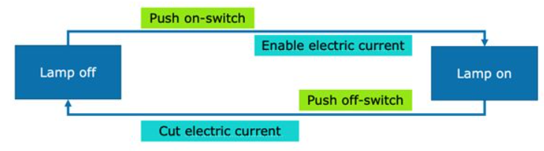
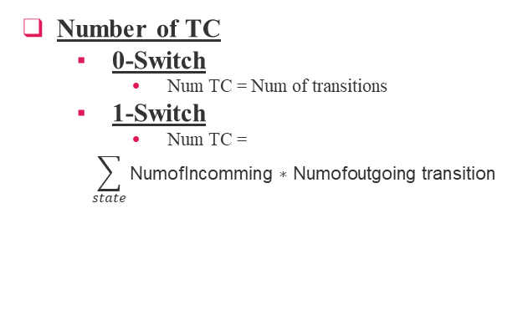
Testing Techniques: State Transition Testing
N-Switch Coverage
0-Switch coverage
Cover one transition at a time
1-Switch coverage
Cover all of the pairs of two valid transitions
Example
State | Push on-switch | Push off-switch
Lamp off | Enable electric current Lamp on | -
Lamp on | - | Cut electric current Lamp off
0-Switch
Test case1: “lamp off – push on-switch – lamp on”
Test case2: “lamp on – push off-switch – lamp off”
1-Switch
Test case1:
“lamp off – push on-switch – lamp on – push off-switch – lamp off”
Test case2:
“lamp on – push off-switch – lamp off - push on-switch – lamp on”
Number of TC
0-Switch
Num TC = Num of transitions
1-Switch
Num TC =
$$\sum_{state}{\text{NumofIncomming}\text{ ∗ }\text{Numofoutgoing} \text{transition}}$$

Slide 13
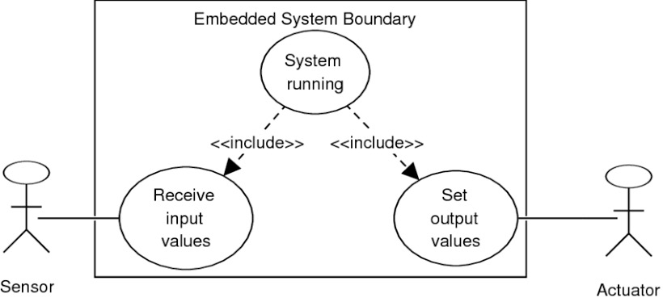
Testing Techniques: Use Case
Use Case Testing is a functional black box testing technique that helps testers to identify test scenarios that exercise the whole system on each transaction basis from start to finish.
Characteristics of Use Case Testing:
Use Cases capture the interactions between 'actors' and the 'system'.
'Actors' represents user and their interactions that each user takes part into.
Test cases based on use cases and are referred as scenarios.
Capability to identify gaps in the system which would not be found by testing individual components
in isolation.
Very effective in defining the scope of acceptance tests.

Slide 14

What is the test case?
A Test Case is a set of actions executed to verify a particular feature or functionality of your software application.
Test cases are being used as a software help guide for the tester through a sequence of steps to validate whether a software application is free of bugs and working as required by the end user.

Slide 15
Why we have to write test cases?
A well-written test case should allow any tester to understand and execute the test.
When writing test cases, it’s important to put yourself in the user’s shoes and include all the necessary details.
Putting forth the extra effort to write good test cases upfront will save you time and effort further down the road.

Slide 16
How to write a test case?

Slide 17
Use a Strong Title
A good test case starts with a strong title.
As a best practice, it’s good to name the test case along the same lines as the module which you’re testing.
For example, if you’re testing the login page, include “Login Page” within the title of the test case.

Slide 18
Make it simple and transparent
Create test cases that are as simple as possible.
They must be clear and concise as the author of test case may not execute them.
Use assertive language like go to home page, enter data, click on this and so on.
This makes the understanding the test steps easy and test execution faster.

Slide 19
Create Test Case with End User in Mind
Ultimate goal of any software project is to create test cases that meets customer requirements and is easy to use and operate.
A tester must create test cases keeping in mind the end user perspective.

Slide 20
Avoid test case repetition
Do not repeat test cases.
If a test case is needed for executing some other test case, call the test case by its test case id in the pre-condition column

Slide 21
Do not Assume
Do not assume functionality and features of your software application while preparing test case.
Stick to the Specification Documents.

Slide 22
Ensure 100% Coverage
Make sure you write test cases to check all software requirements mentioned in the specification document. Use Traceability Matrix to ensure no functions/conditions is left untested.

Slide 23
Keep the Test Steps Clear and Concise
The test steps should include the data and information on how to execute the test.
This is perhaps the most important part of a test case.
Keep this section clear and concise, but don’t leave out any necessary details.

Slide 24
Test Cases must be identifiable
Name the test case id such that they are identified easily while tracking defects or identifying a software requirement at a later stage.

Slide 25
Implement Testing Techniques
It's not possible to check every possible condition in your software application.
Testing techniques help you select a few test cases with the maximum possibility of finding a defect.
Boundary Value Analysis (BVA).
Equivalence Partition (EP)
State Transition Technique.
Error Guessing Technique

Slide 26
Repeatable and self-standing
The test case should generate the same results every time no matter who tests it

Slide 27
Make it Reusable
A good test case is reusable and provides long-term value to the software testing team.
When writing a test case, keep this in mind. You can save time down the road by re-using the test case instead of re-writing it.

Slide 28
Conduct Peer Review
After creating test cases, get them reviewed by your colleagues.
Your peers can uncover defects in your test case design, which you may easily miss..

Slide 29
Test Case Construction
Title
Summary
Description
Precondition
Test Steps
Expected Result
Test Case
Post Condition
Attachments
Type
Status
Designed By

Slide 30
Test cases Types

Slide 31

Test case Types
Functionality Test Cases
Performance Test Cases
Integration Test Cases
User Acceptance Test Cases

Slide 32
Functionality Test Cases
Used to discover if an application’s interface works with the rest of the system and its users.
The tests identify the success or failure of functions that the software is expected to perform.
The cases are a type of black-box testing that uses for its base the specifications or user stories of the software under test.
This allows the tests to be performed without needing access to the workings or internal structures of the software being tested.
Examples:
-Confirming a user can successfully upload a profile photo.
-Login with Valid credentials
-Activate data package for postpaid user
32

Slide 33
Performance Test Cases
Validate response times and overall effectiveness of an application.
That is, after executing an action, how long does it take for the system to respond? Performance test cases should have a very clear set of success criteria.
Performance test cases help understand how the application will perform in the real world.
Example:
How long does it take for the system to authenticate a user and load the next page? When multiple people login at the same time, does the application remain stable?
33

Slide 34
Integration Test Cases
Integration test cases are meant to determine how different modules interact with each other.
The main purpose with integration test cases are to ensure interfaces between the different modules are working properly.
They verify that modules that are already working individually are also able to work together.
Example:
Checking the link between the home page and the “favorites” section. When you add an item as a “favorite”, from the homepage, does it appear in the “favorites” section?
34

Slide 35
User Acceptance Test Cases
User acceptance test cases, or “UAT” test cases, help the team test the user acceptance testing environment.
These test cases should be broad, covering all areas of the application.
The purpose of these test cases isn’t to find bugs (hopefully they’ve already been found and fixed in previous testing), but to verify the application is acceptable to the user. So, when they execute a test, are the results of that test, and the experience of that test acceptable?
Example:
If testing for instance, a photo management application for a photography studio, the client (the user) should test that they are able to upload and manage their photos in a way that fits their business needs.
35

Slide 36
Thanks!

